Slide 1
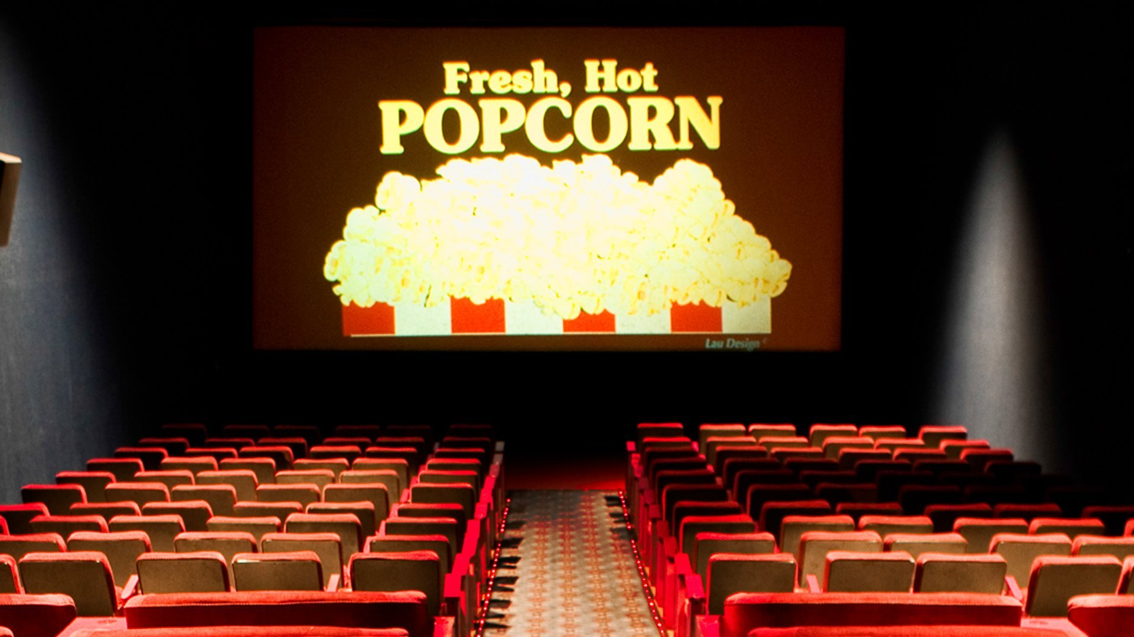
Marcus’ Movie Manual
A look at what made high production cost Action and Adventure films incredible successes or miserable failures.
By Marcus Madison

Slide 2
Table of Contents
Background and Experience
Data Sources
Business Question/ Objective
Early Discoveries
Why action/adventure
MPAA Rating
Duration
Review Scores
Success Over the Years

Slide 3
Background and My Experience
Recently have been mostly into Thriller and Horror films, so was curious about their performance and chances of being successful, Mystery and suspense is cool too.
Nothing else really

Slide 4
Data Sources
Massive Rotten Tomatoes Movies & Reviews
Top 500 Movies by Production Budget
IMDb 5000+ Movies & Multiple Genres Dataset

Slide 5

Business Question/ Objective
How did production cost vary across mpaa rating, did it have an impact on its review scores?
Does the duration of a film play a factor in it’s return on investment, do the audience or critics have a certain preference?
Are audience and critic ratings correlated at all? Negatively or Positively?
Which action and adventure movies had the greatest ROI for every year? How do they compare to the other movies?

Slide 6
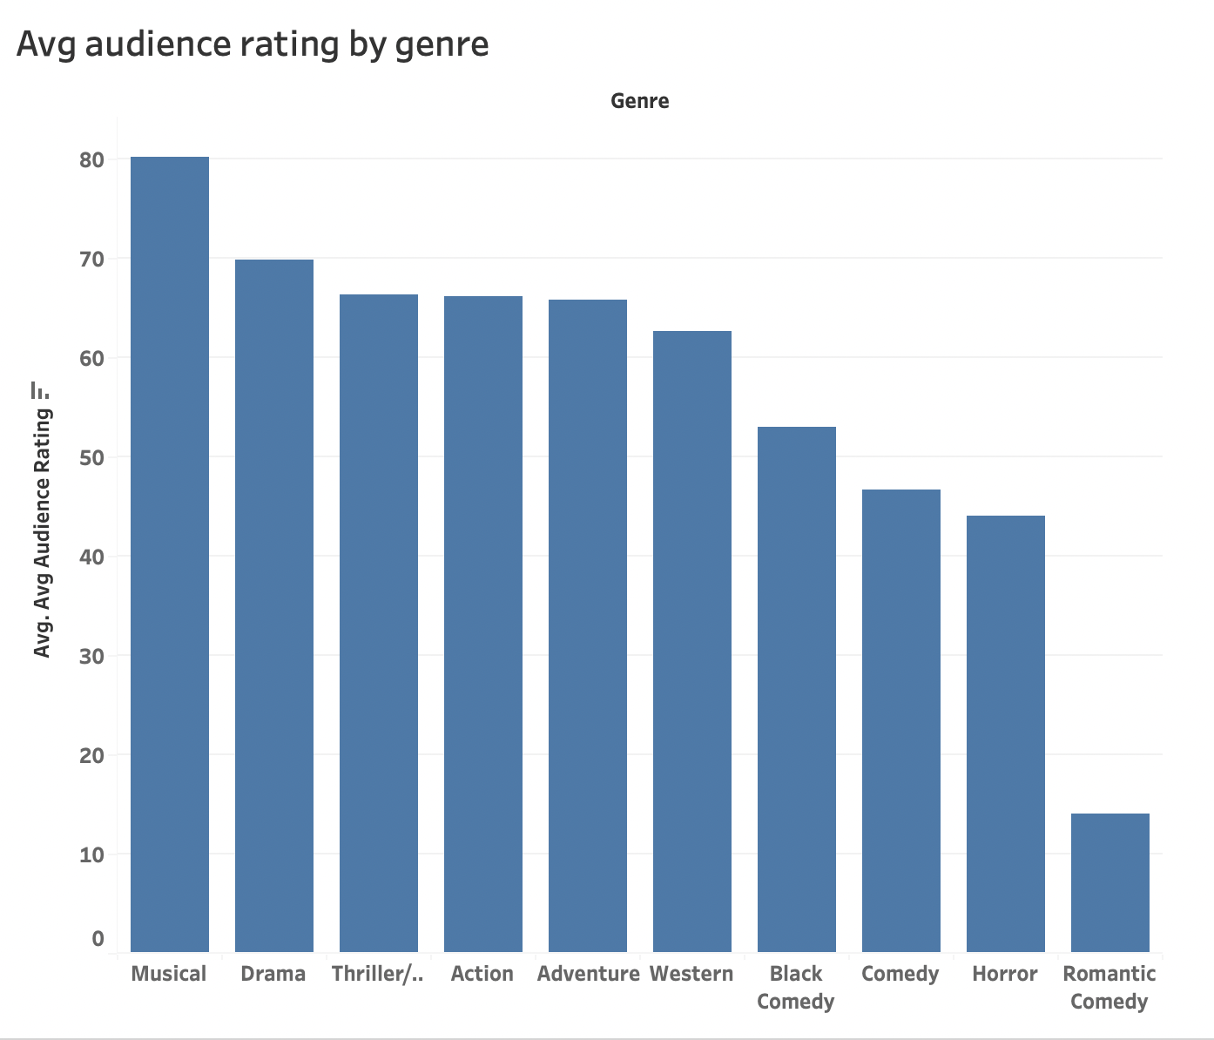
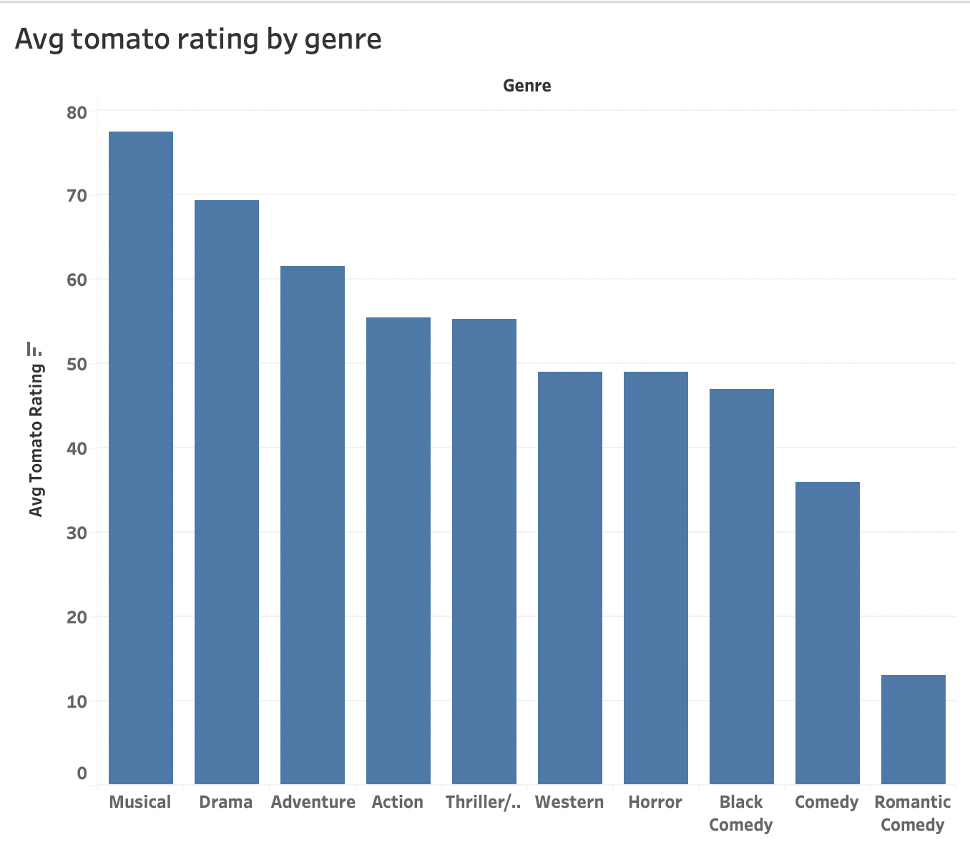
Early Discoveries
As I began my analysis, some things in my analysis confused me. Initially Music was dominating out of all the Genres. Are musicals really that good?
Null

Slide 7
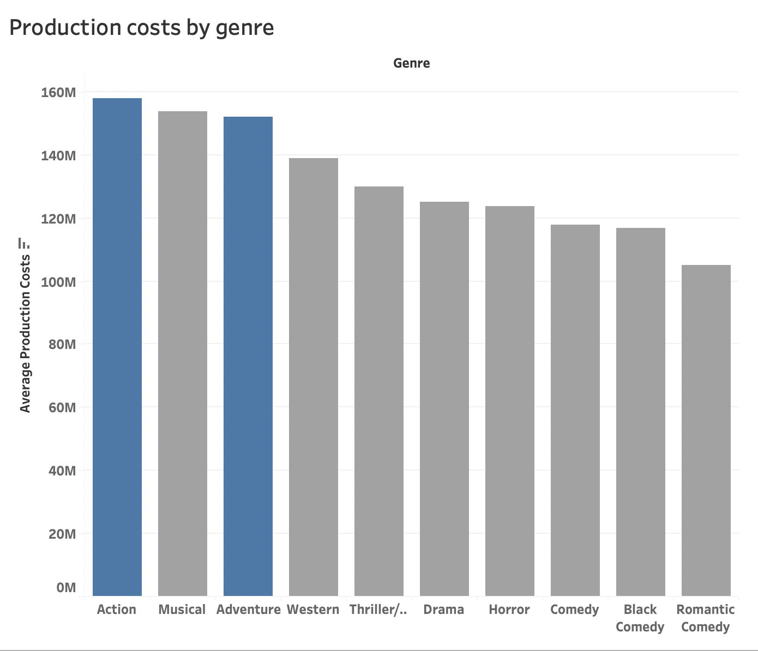
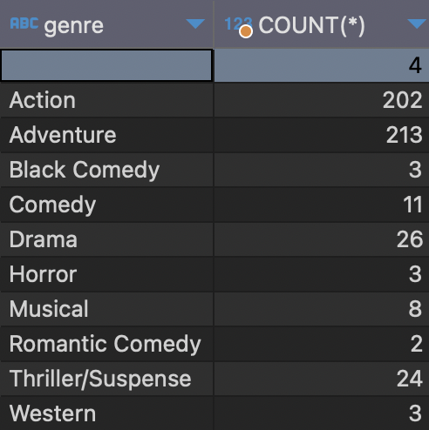
Why action/adventure?
Both genres contained the most movies in the dataset, it wasn’t even close. I thought this would impact the data
They also were two of the genres with the highest production costs.

Slide 8
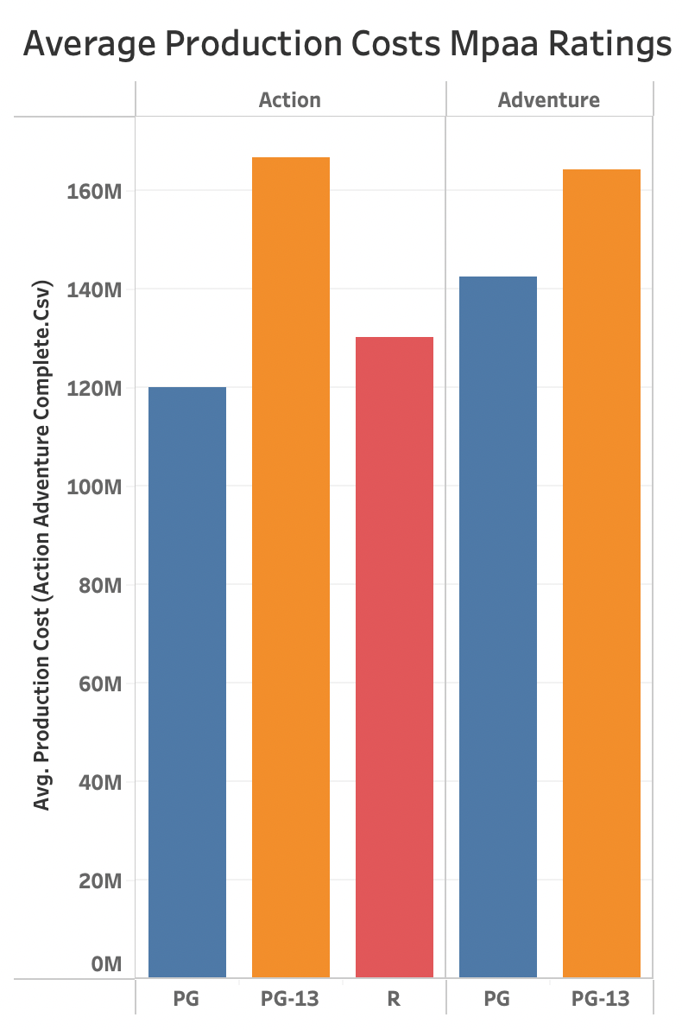
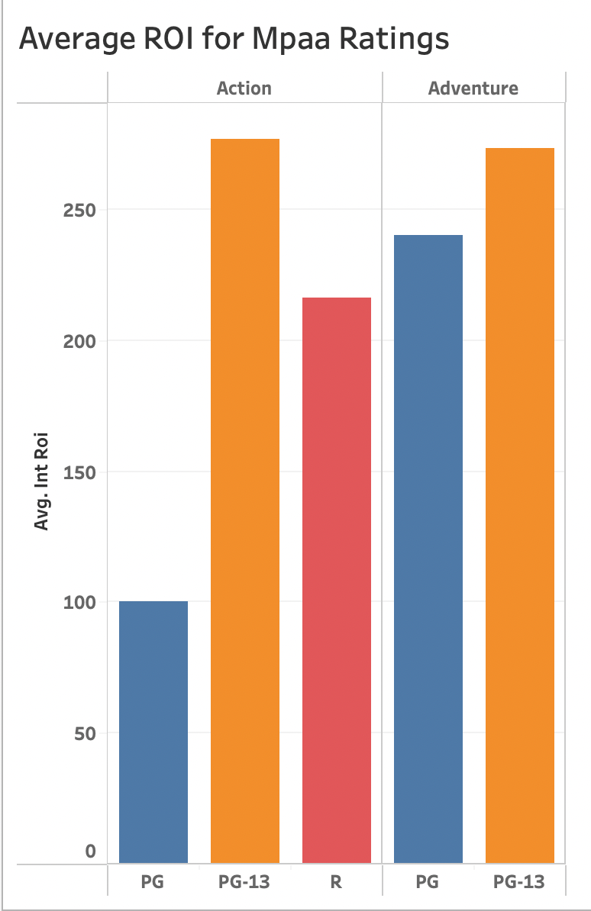
Mpaa Ratings
I wanted to see which movies cost
the most to make by looking at
Productions cost by MPAA rating.
PG-13 is the most
profitable MPAA rating for both
Action and Adventure.

Slide 9
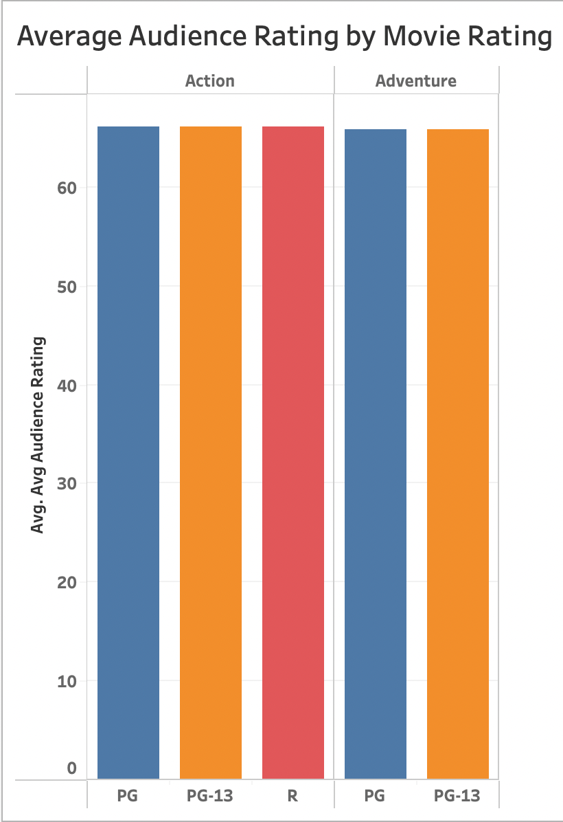
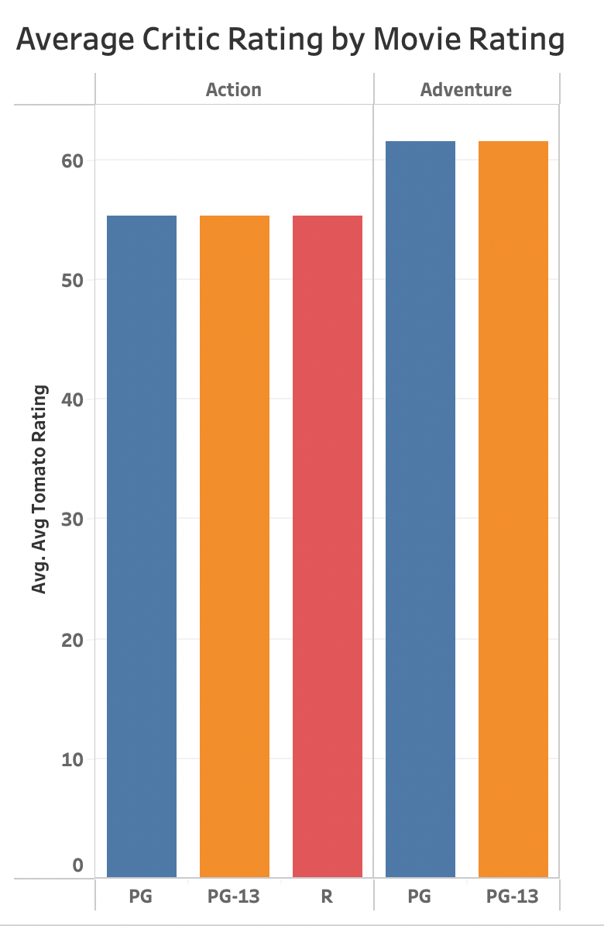
After looking at the relationship
between Mpaa ratings and review ratings there doesn’t seem to be any significant connection at all.
So, what's next?

Slide 10
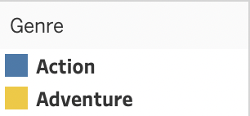
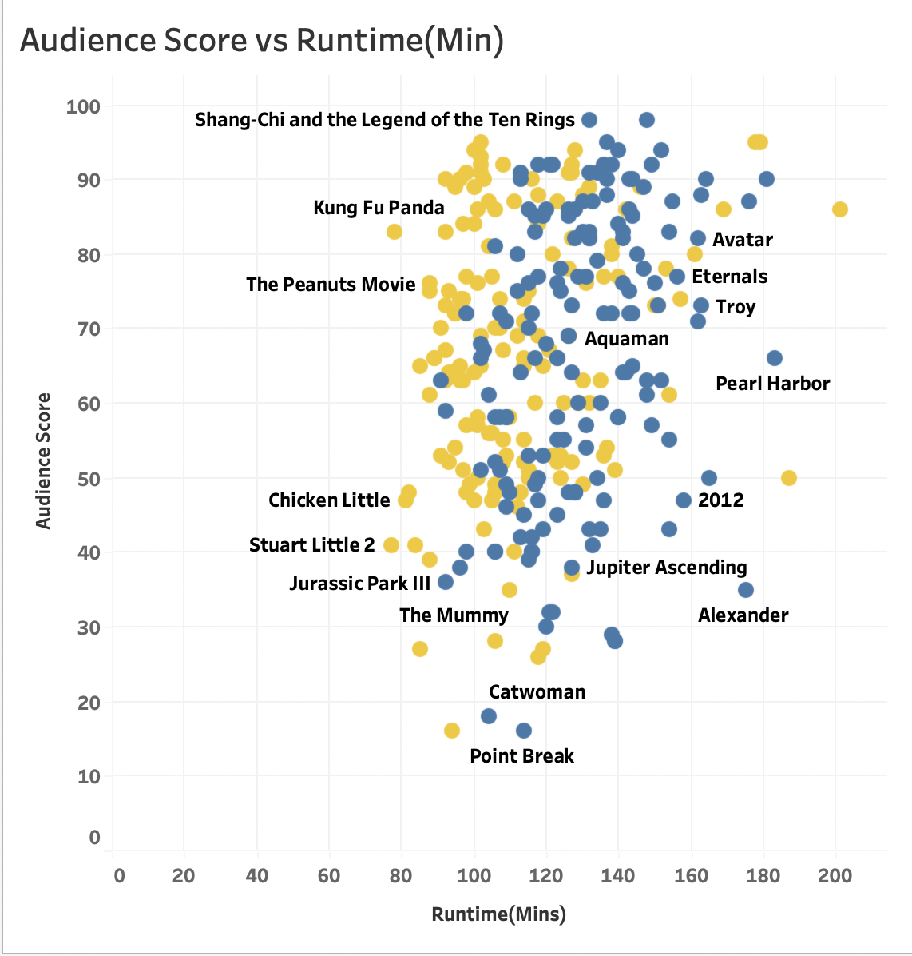
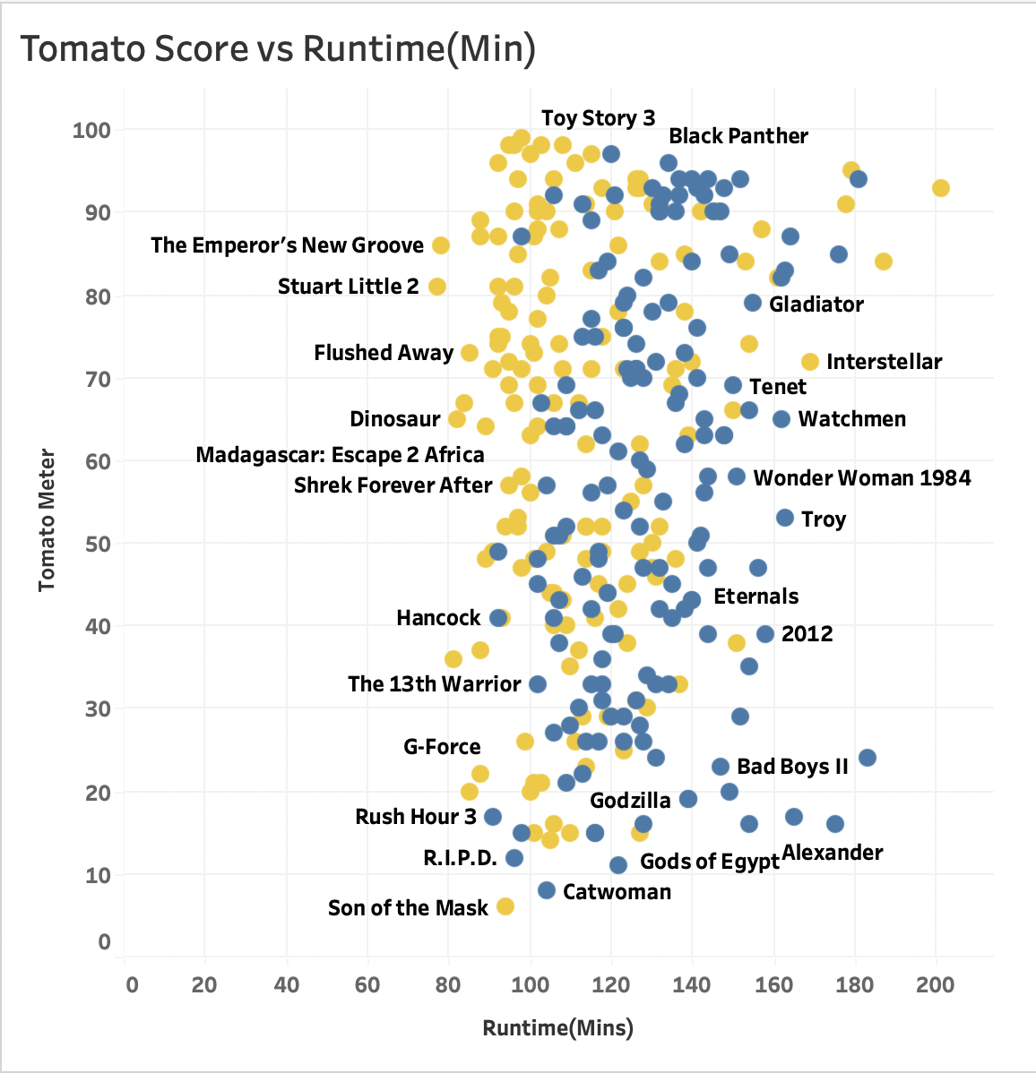
Duration: What do the viewers think?

Slide 11
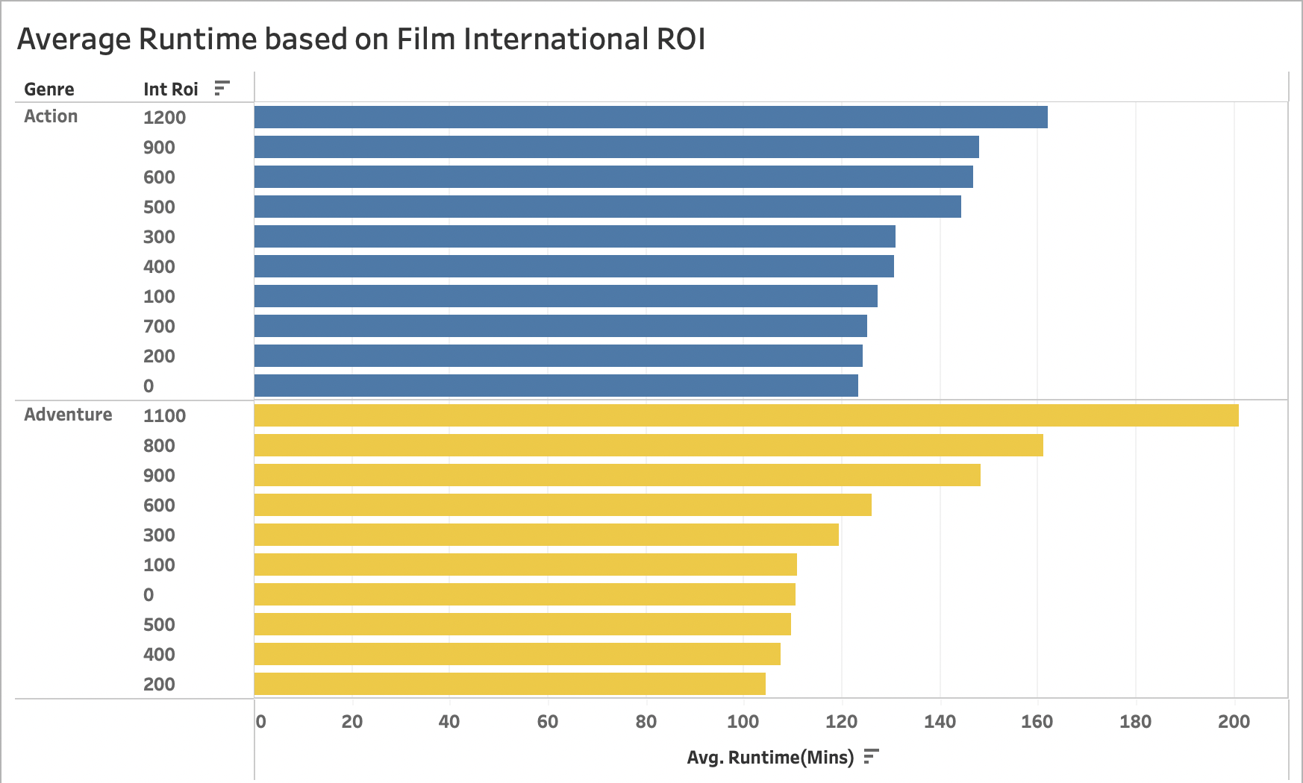
Will Duration affect the ROI?
It seems to some extent that the duration does have a significant impact. For both genres the longest average runtime is associated with the highest international ROI.
An ROI represents the ”return on investment”, in this case of films. Based on how much they spent, how much were they able to earn back.
An ROI of 100 would be breaking even, 200 would be doubling your expenditures and so on.

Slide 12
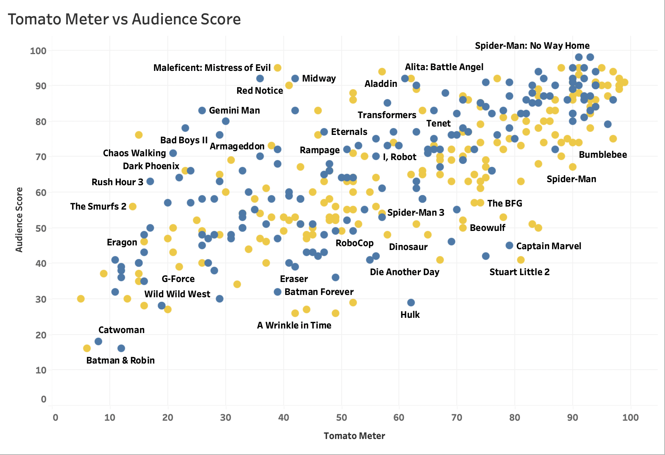
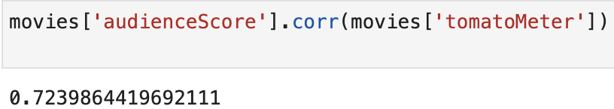
A Connection Between Viewers?
While cleaning, I noticed a significant positive correlation between Audience and Critic Review scores. This is visible in the scatterplot as the data points trend up in a positive manner.
However, this is not always the case.

Slide 13
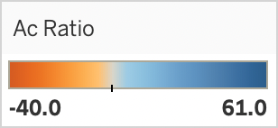
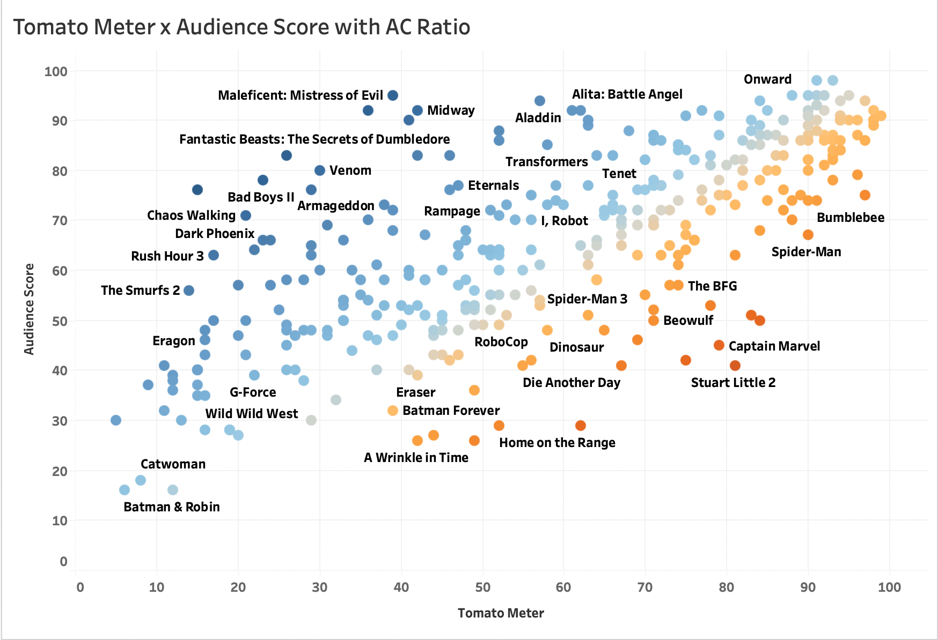
Conflicting Review Scores
In the data there are countless times where the critics and audience disagree about a review score.
By subtracting critic scores from audience scores I created a metric (AC Ratio) to be able to see how in synch the audience is with Rotten Tomatoes.
Stuart Little 2 was the top critic favorite with a score of 81 and 41 by the audience. Dolittle was it’s antithesis with an audience score of 76 and a critic score of 15.

Slide 14
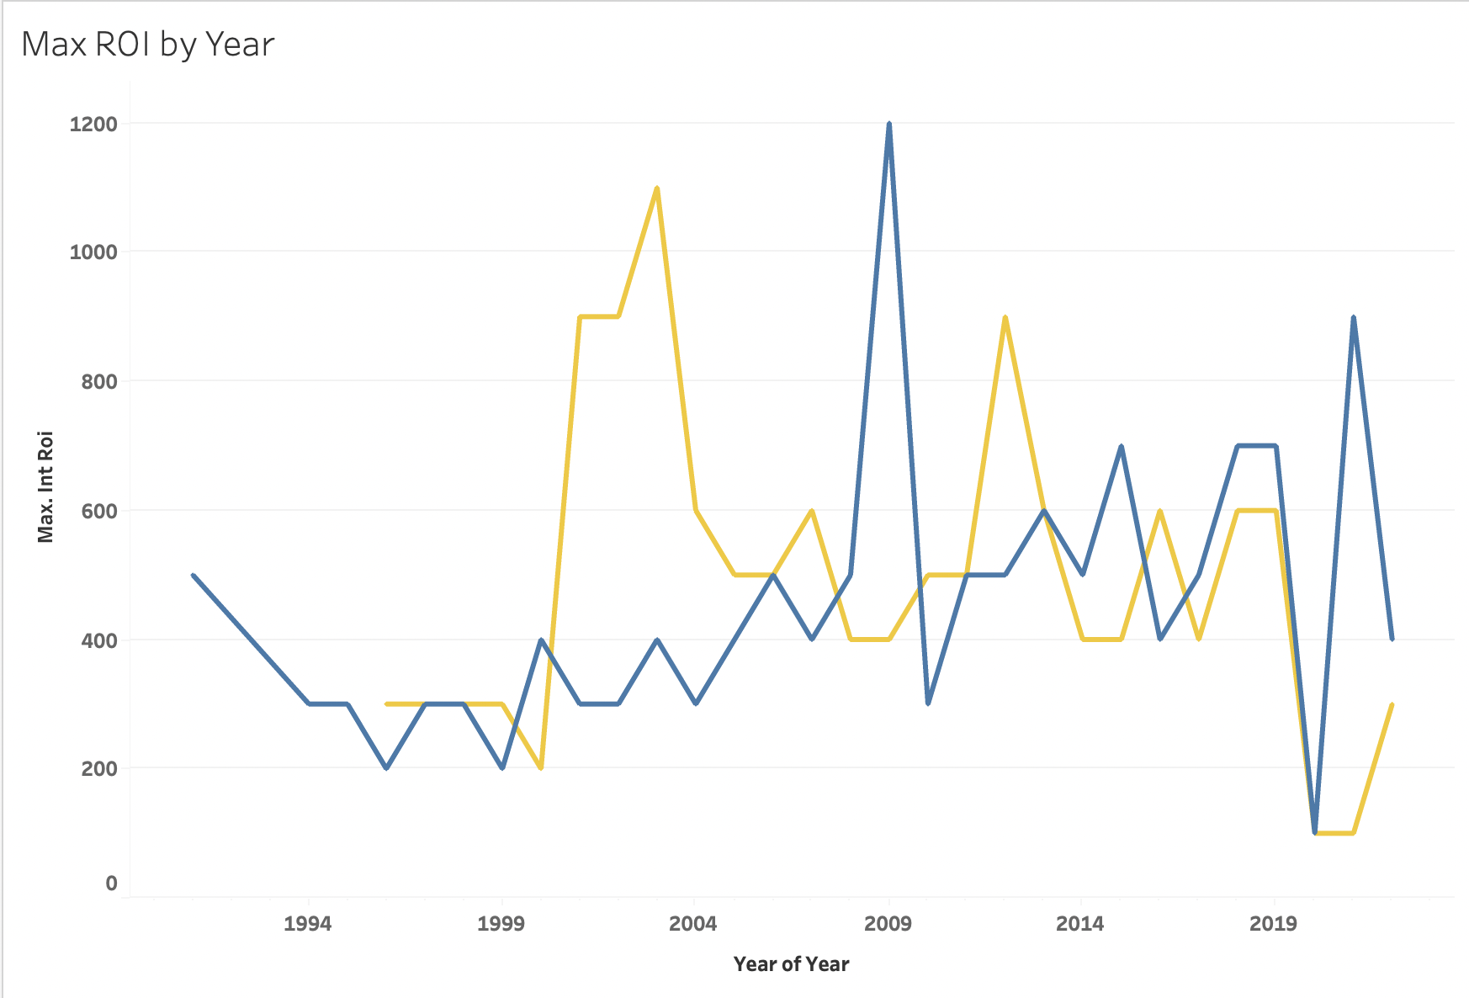
Success Over the Years
Over time both Action and Adventure had amazing films that proved to be incredible successes seen.
There is a dip around 2020, most likely due to the pandemic, but only one genre seems to be on the way to recovery

Slide 15
MARCUS’ SUGGESTION!
Production Cost isn’t everything, but it helps.
Stick to PG and PG-13 movies, more people can watch them and run up sales
Target series and fanbases, they are loyal and are a steady foundation for sales
Movies based on Books! Book to Film adaptations.
Look at some extremely successful movies through this dashboard!

Slide 16
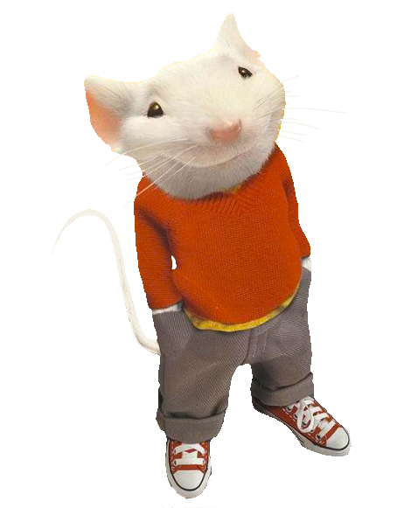
Next Steps/ Aspirations
Look at successful rated R movies, compare them to those elite outliers
Look further into ac ratio, what do the discrepancies signify if anything at all?
Watch the critically acclaimed Stuart little 2
Compare film series’, who made the most, who spent the most?
Mpaa dominance over time, for every year are the same ratings
Continuing to lead the ROI battle.

Slide 17

THANK YOU!!!
Fullstack Staff: Dennis, Vadim, Monica, Myra, Aisha, MaryBeth
Helping me through one of the most challenging projects I’ve worked on.
NY TTP: For investing in the cohort providing us with a chance to learn
2301 Cohort: One of the greatest developmental environments I’ve been a part of. I have never been somewhere where I felt comfortable to make mistakes publicly and learn from others.
Tools: Excel and Python – Data Cleaning, SQL – Data Exploration, Tableau -Visualizations

